Slide 1
Crime Data for New York City
Benjamin Grossmann

Slide 2
Source of the Data Set
NYC OpenData ( https://opendata.cityofnewyork.us/ )
Data Set Being Used: NYPD Complaint Data Current (Year To Date) 450 Thousand Rows
Related Data Set: NYPD Complaint Data Historic 7.38 Million Rows

Slide 3
Data Cleaning and Selection
Data Set Description
36 columns
449,506 rows
String values in uniform formats (corrections not needed)
Each row has unique identifier (no duplicate rows)
Data Selection for Analysis
Target the Offense Severity (Violation, Misdemeanor, Felony)
Identify Data at the Precinct Level 77 Precincts in NYC
Unique Identifier Set as Index
Keep newly created duplicates 1576 duplicates (0.35% of all rows)
Rows by Year
Keep year 2020 439,625 rows (97.8% of all rows)
Drop years prior to 2020 9,881 rows (2.2% of all rows)

Slide 4
Keeping and Dropping Columns
Columns with Location Information
Keep Precinct Identifier Column
Keep Premise Type (ex: Residence, Bank, Bridge)
Drop Locations that are too General, too Specific, or Redundant (Borough, Patrol Borough, Global Coordinates, New York State Plane Coordinates )
Could revisit Latitude and Longitude for another analysis
Drop Description at Location (ex: Inside, Outside, Front of)
Columns with Time and Date Information
Keep Date and Time Offense Begins
Drop Date and Time Offense Ends [Null Values Present]
Drop Date Report is made

Slide 5
Keeping and Dropping Columns
Columns with Special Names
Drop Named Locations [Null Values Present] (Parks, Housing Developments, Transit Stations, Transit Districts)
Correspond to Unnamed Premise Types (ex: Park/Playground, Residence - Public Housing, Transit - NYC Subway)
Columns with Special Codes
Drop Offense Description
Could be target for another analysis
Drop Columns Adding Details to Other Columns
Drop Columns that Assign Numerical Value to Categorical Column Values
Columns with Suspect and Victim
Drop Suspect and Victim [Null Values Present]

Slide 6
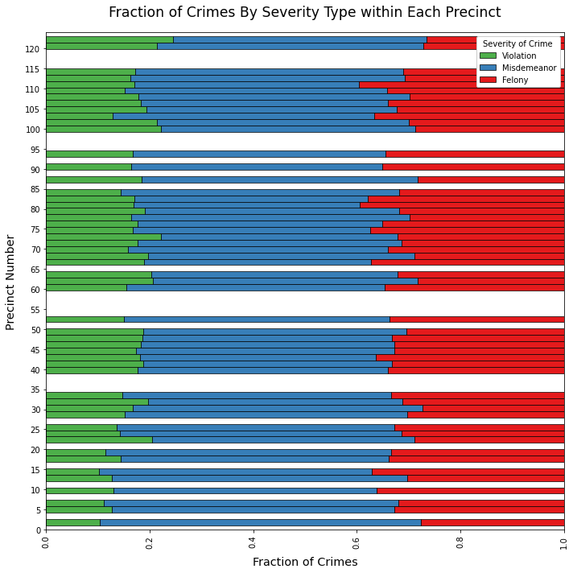
Precincts have Similar Ratios of Crime Severities
≈ 15% Violations
≈ 30% Felonies
≈ 55% Misdemeanors

Slide 7
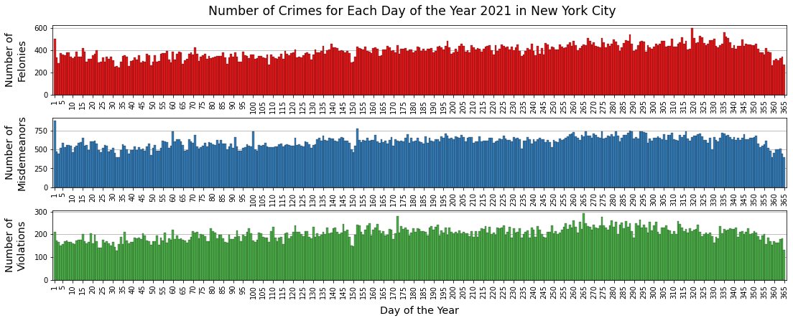
Crime Rates Rose Throughout 2021

Slide 8
Date Values: Strings to Numbers
Errors when attempting datetime conversion
Tracked down to years 1019, 1021
Dropped all years before 2021
Dates in format “mm/dd/yyyy”
Used slice on Date string filter_2021 = df["CMPLNT_FR_DT"].apply(lambda x: x[6:])=="2021" df = df.loc[filter_2021, :]
Converted with pd.to_datetime()
Values didn’t play nice in some graphs (especially correlation heatmap)
Solution: Converted to integer day of year (1 through 365) df["CMPLNT_FR_DT"] = pd.to_datetime(df["CMPLNT_FR_DT"]) df["CMPLNT_FR_DT"] = df["CMPLNT_FR_DT"].apply(lambda x: x.timetuple().tm_yday)

Slide 9
Time Values: Strings to Numbers
Datetime conversion always added year and day to time
When year remove, data type didn’t work in graphs and calculations
Times were to the minute
Graphing time of day was not pleasant visually (Histogram with 1,440 bars for one offense level)
Solution: Binned time into 15 minute intervals, and convert to decimal fraction of hour
Times in format “hh:mm:ss”
Use slice on Time string df["CMPLNT_FR_TM"] = df["CMPLNT_FR_TM"].apply(lambda x: int(x[:2]) + np.floor(int(x[3:5]) * 1 / 60 * 4 ) * 0.25)

